Slide 1


SIGN LANGUAGE TO SPEECH TRANSLATOR
Vikas - 03620902819
Ruchita Singh - 05420902819
Praveen Pushkar -00620902819
Guided By
Dr. Krishna Singh

Slide 2
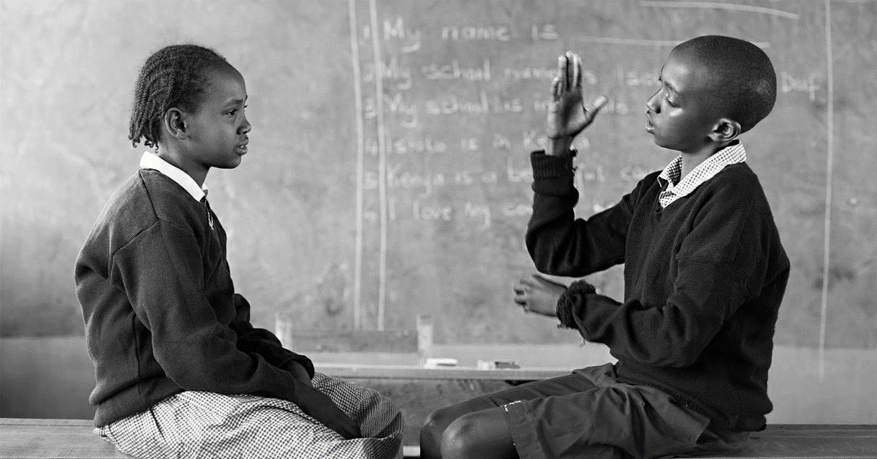
PROBLEM STATEMENT
People unable to speak and listen who use hand signs to communicate and hence normal people face problem in recognizing the signs made by them.
Hence there is a need of the system which recognizes the different signs and conveys the information to the normal people.

Slide 3
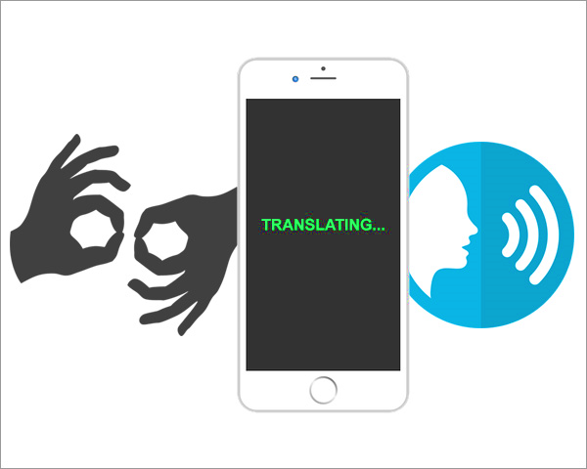
AIM
To develop a software for automatic translation of Sign language into Speech to assist the communication between speech and/or hearing impaired people with normal people.

Slide 4
INTRODUCTION
Natural way of communication of speech for hearing-impaired and for people who are unable to speak.
• Sign
Movement of one or both hands, accompanied with facial expression, which corresponds to a specific meaning.
• Sign Language Translator
A sign language translator is a person trained in translating between a spoken and a signed language.

Slide 5
OBJECTIVE
• Sign to Speech conversion
1. Acquire images using the inbuilt camera of the device.
2. Perform vision analysis functions in the operating system and provide speech output through the inbuilt audio device
• Minimize hardware requirements and expense.

Slide 6






TOOLS AND TECHNOLOGIES
Python
IDE :
JupyterLab
Python Libraries:
Keras
Numpy
OpenCV
gTTS
Matplotlib
Playsound

Slide 7
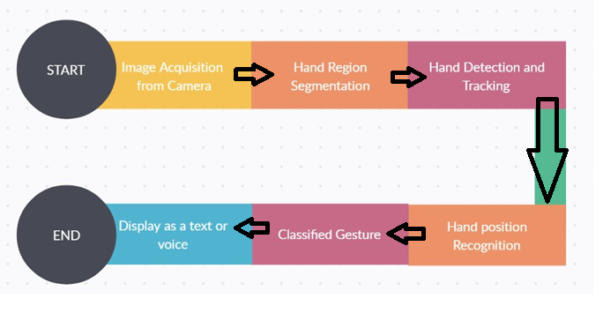
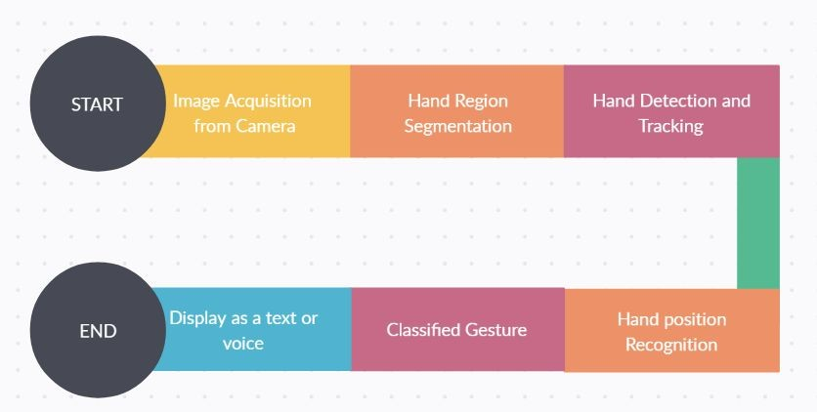


PROCESS FLOW

Slide 8
Project Segmentation
Preprocessing
Training Model
In the preprocessing of the dataset, the dataset was loaded and transformations were done on the dataset
CNN model was developed for training and prediction

Slide 9
How to Use Project
Open ASL_realTime.ipynb file
Make gestures in the given box present on screen as input
Open the project directory
1
3
5
2
4
6
Open Jupyter-notebook from cmd
Run all the cells
Output is generated
on screen

Slide 10
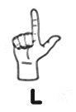
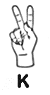
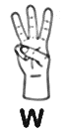
ASL Alphabet Chart

Slide 11
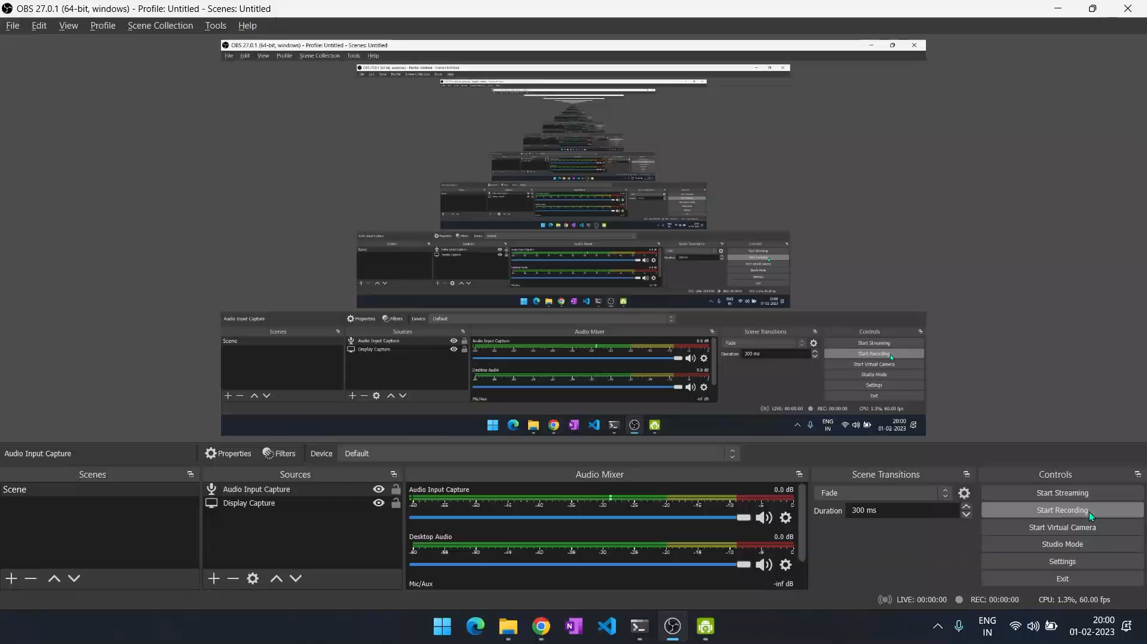

Slide 12
Future Scope Of The Project
Implementation of two-way communication
Focus on Facial Expressions
Recognize signs which include motion
Minimize time taken for recognising

Slide 13
THANK YOU!

